Slide 1
CREDIT EDA CASE STUDY
By Richard Samuel & Hareesh Rajasekharan
30th July 2021

Slide 2
Problem Statement
The loan providing companies find it hard to give loans to the people due to their insufficient or non-existent credit history. Because of that, some consumers use it as their advantage by becoming a defaulter.
Suppose you work for a consumer finance company which specializes in lending various types of loans to urban customers. You have to use EDA to analyse the patterns present in the data. This will ensure that the applicants capable of repaying the loan are not rejected.
There are 2 types of risks are associated with the bank’s decision:
Non-default -If the applicant is likely to repay the loan, then not approving the loan results in a loss of business to the company
Default- If the applicant is not likely to repay the loan, The applicant is likely to default, then approving the loan may lead to a financial loss for the company.

Slide 3
Analysis & data cleaning
Check the Null-Values, Outliers, Data imbalance & Percentage
Dropping unnecessary columns from the data frame
Analyzing the least null-Values columns >= 14% and value distribution
Binning & Splitting important columns for analysis
Performing Univariate & Bivariate analysis for Non-defaulter and Defaulter
Finding and analyzing the correlation between Non-defaulter and defaulter

Slide 4
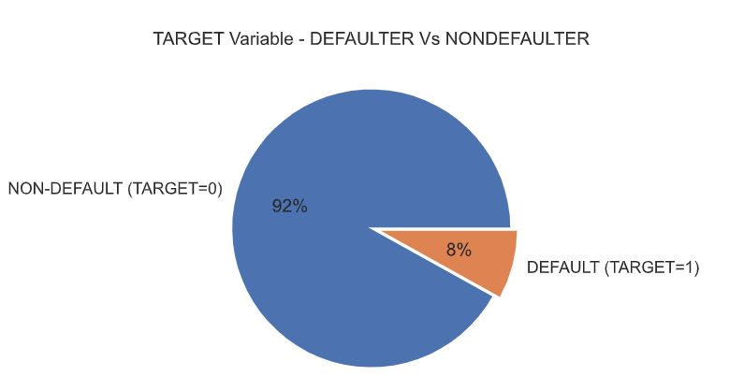
Proportion of Defaulter Vs Non-default
The percentage of people who have defaulted is more than 92%
The percentage of people who have not defaulted is 8%

Slide 5
Univariate analysis for Non-defaulters and defaulters

Slide 6
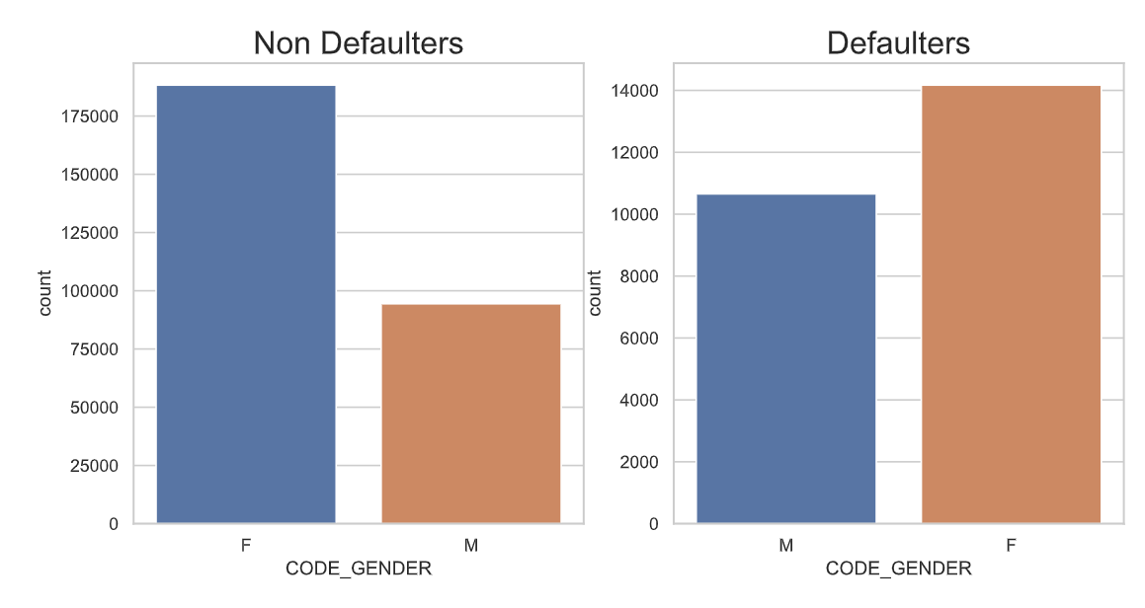
Distribution of Gender imbalance
Points to be considered from the graph on the right.
Non-Defaulter
Female clients are higher, and their range is 177K
Male clients are 50% lower than female
Defaulter
Difference of male and female clients are 3.5K

Slide 7
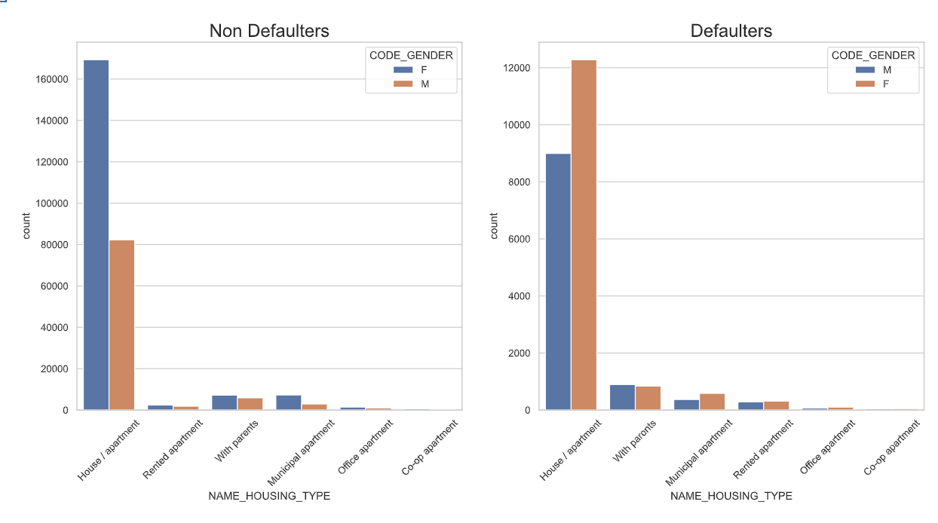
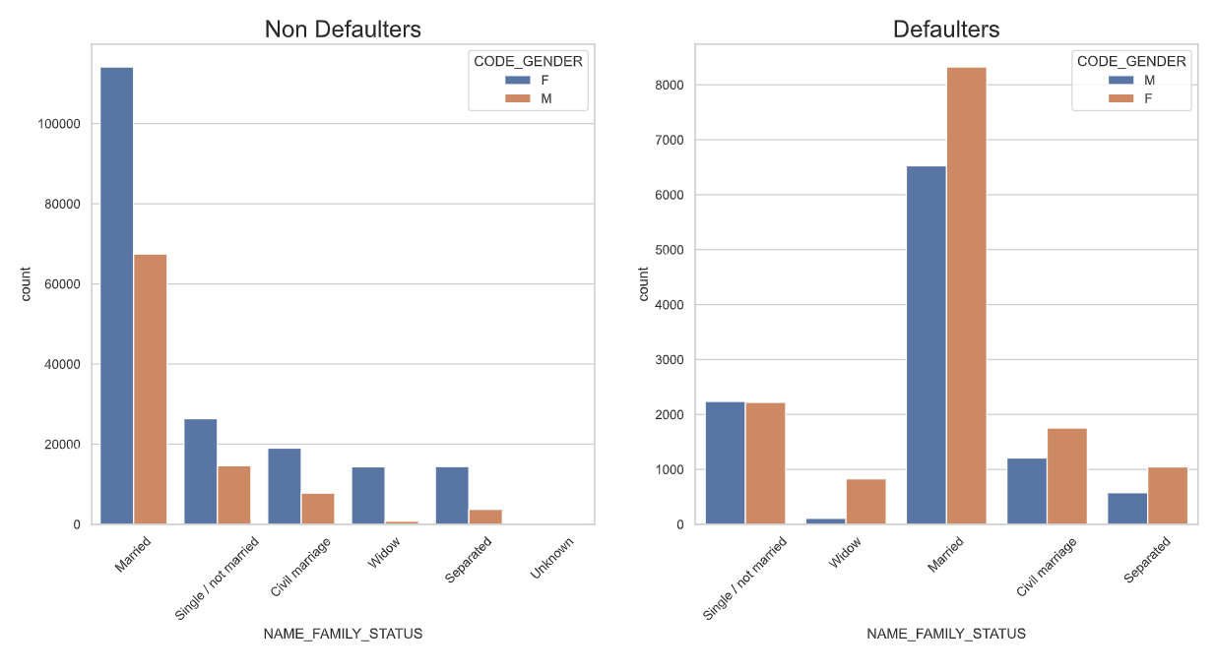
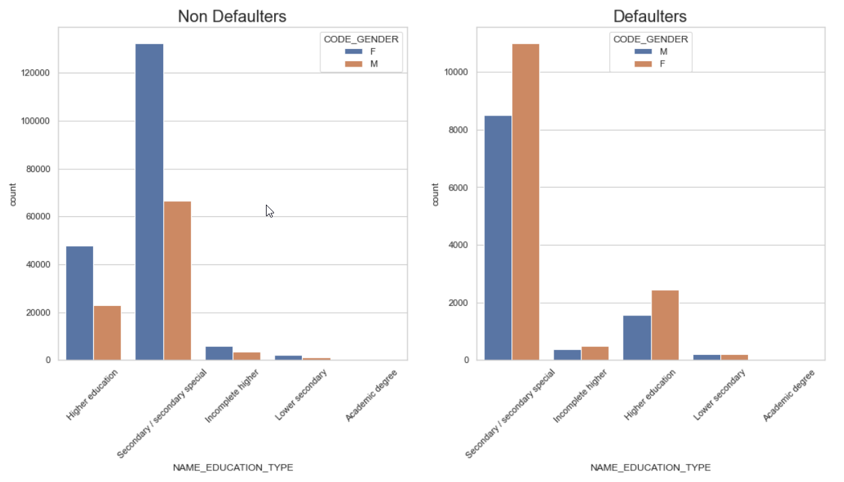
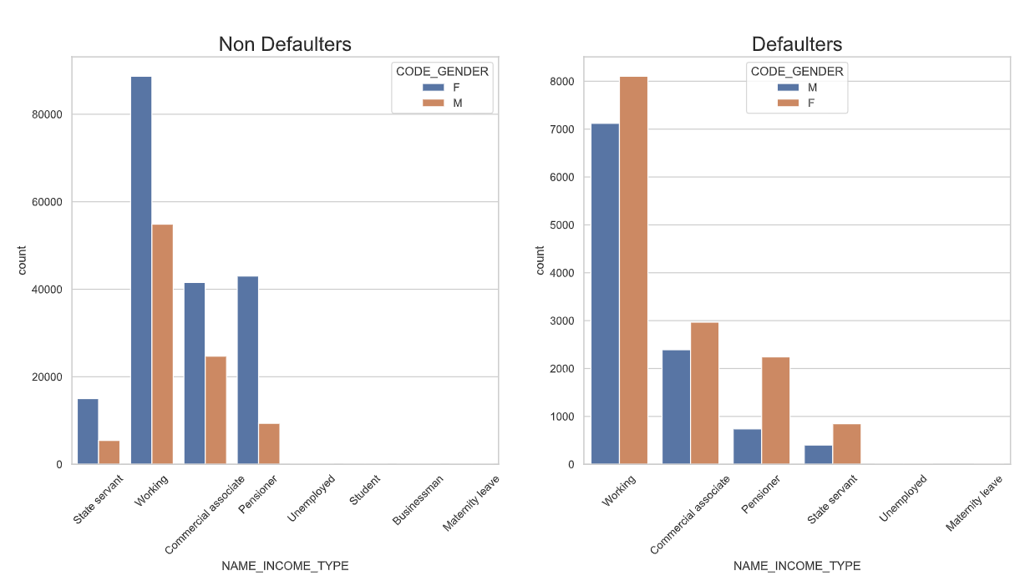
Analysis of family-status, education, income & housing-type

Slide 8
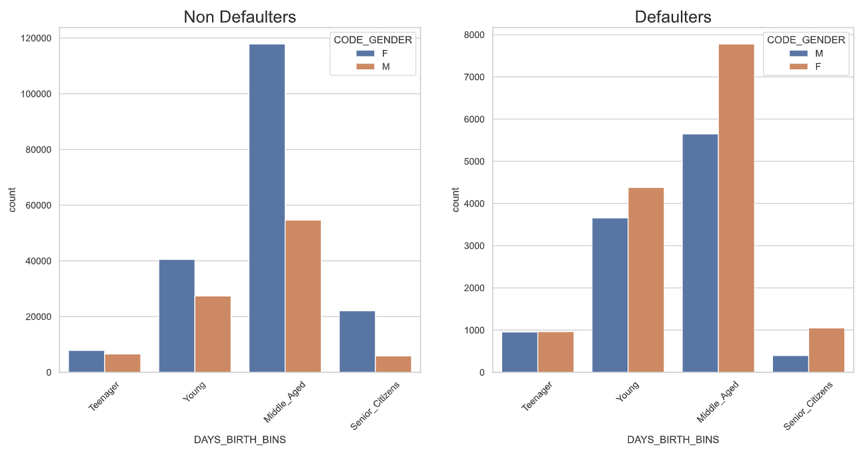
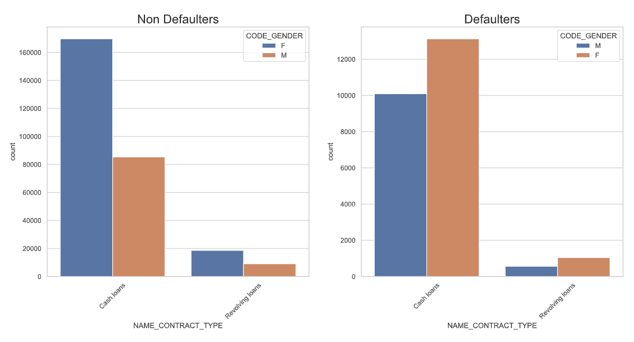
analysis of
age-range and contract-type
Major clients are middle-aged
Middle-aged Female clients are key defaulters
Most of the clients are interested and availed Cash loans.

Slide 9
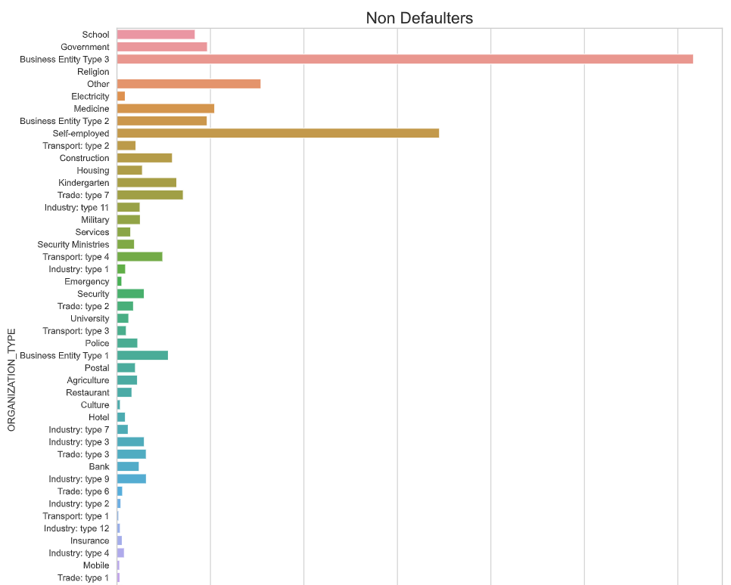
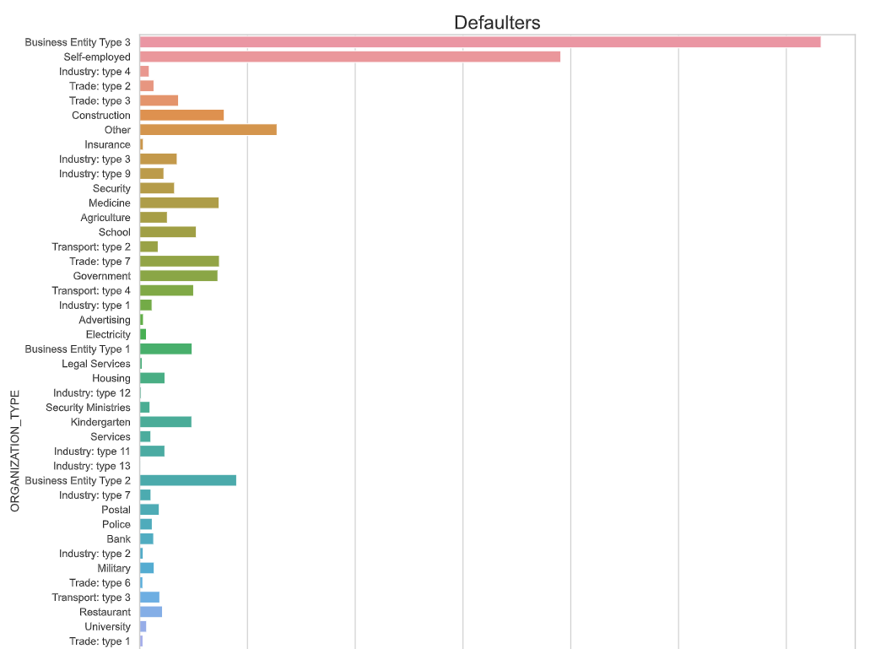
Proportion of Occupation types
Business and Self-employed are major clients
Self-employed, kindergarten and government sectors are less in defaulter

Slide 10
Bivariate Analysis for Target = 0 (Non-Defaulters)

Slide 11
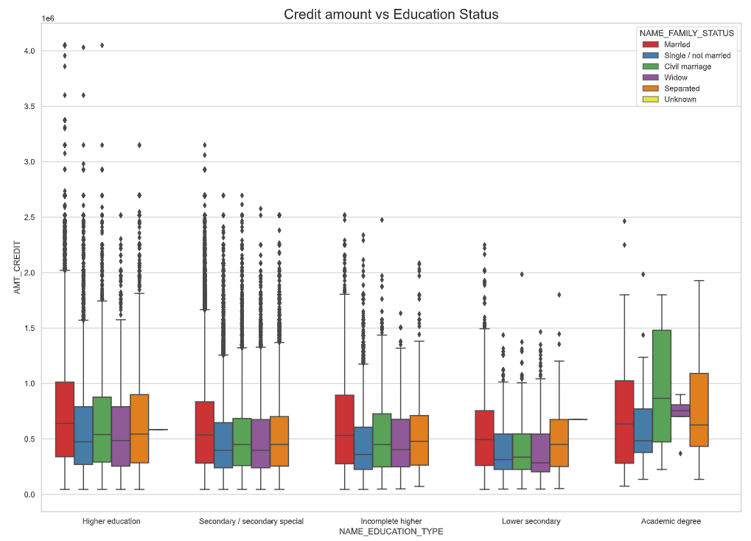
analysis of Credit amount vs Education Status
Observations from the graph.
Maximum credits are given to the applicants having Family status of ‘Civil marriage', ‘Married' and ‘Separated’ with “Academic degree” education.
More outliers are observed in the Higher education category.
Married , Single & Separated are having more outliers.
Civil marriage for Academic degree is having most of the credits in the third quartile.

Slide 12
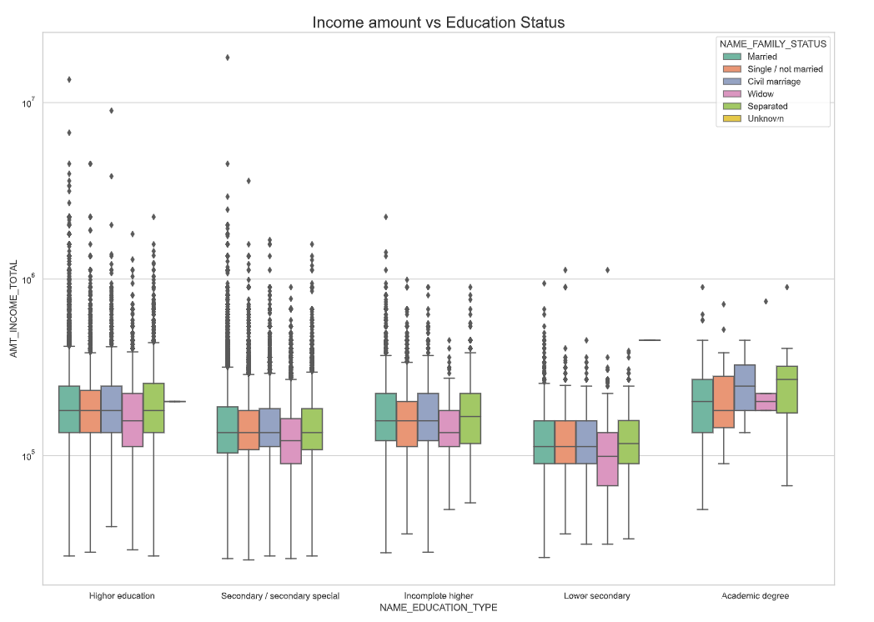
analysis of Income vs Education Status
Observations from the graph.
In 'Higher education' the mean of the income amount is equal with family status. Not much outliers seen.
In Academics less outliers seen but the income amount is higher in Higher education.
Less income amount seen in Lower secondary of Widow(family status).

Slide 13
Bivariate Analysis for Target = 1 (Defaulters)

Slide 14
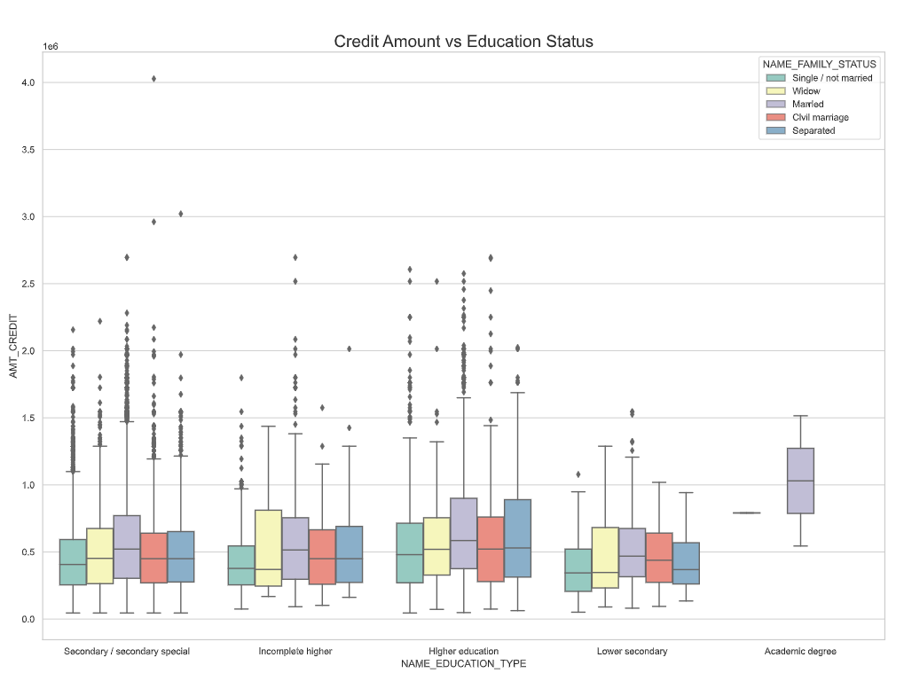
Analysis of Credit amount vs Education Status
Observations from the graph.
Family status of 'civil marriage', 'marriage' and 'separated' of `higher` education are having higher number of credits than others.
Most of the outliers are from Education type 'Higher education' and 'Secondary'..

Slide 15
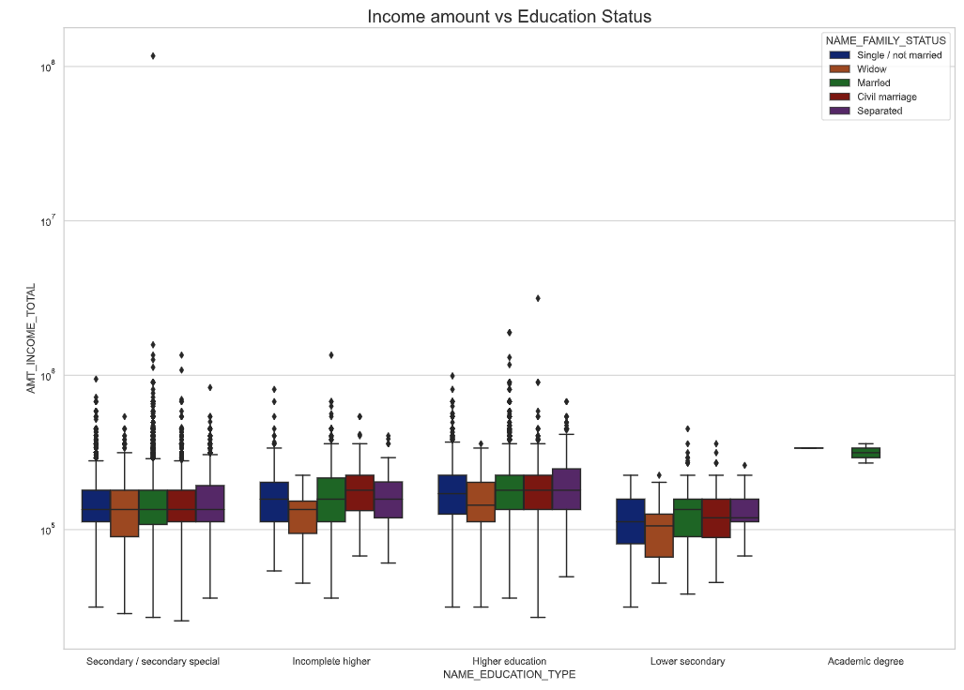
Proportion of Credit amount vs Education Status
Observations from the graph.
The income amount is equally distributed among all family status in Higher education category.
Lower secondary education category is having less income compared to others.

Slide 16

correlation Analysis for non-Defaulters and defaulters

Slide 17
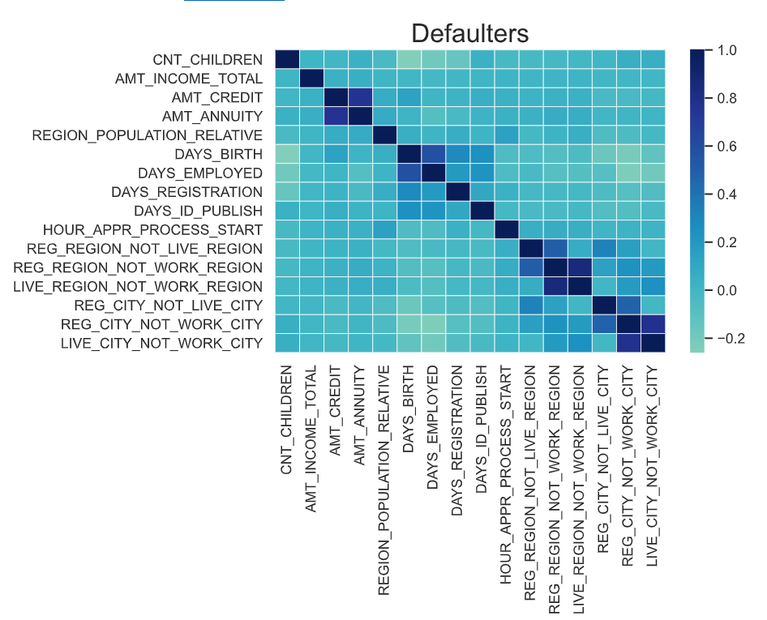
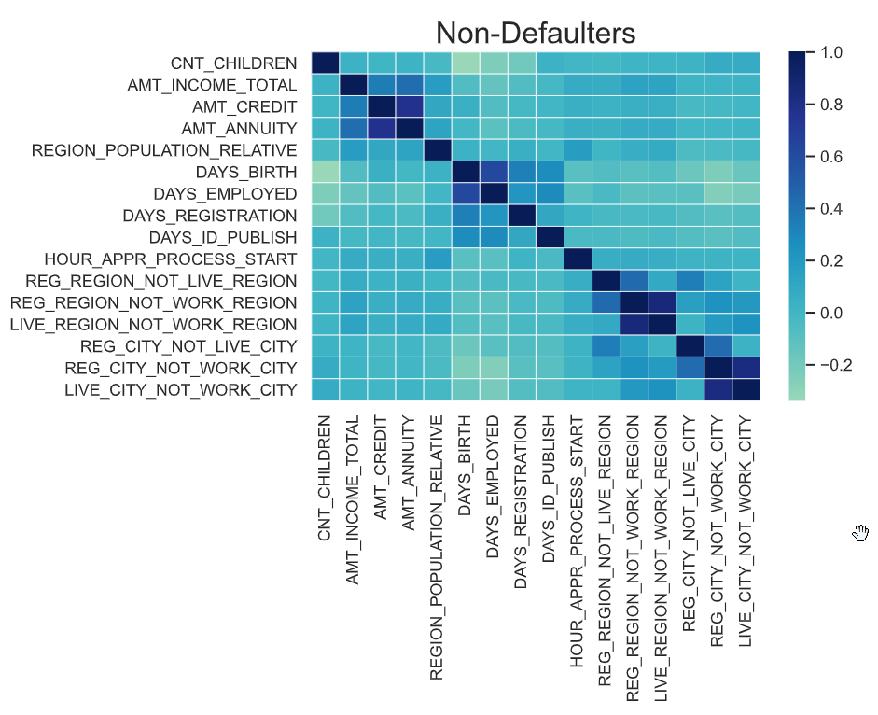
Correlation for
non-defaulters and defaulters
Credit amount is higher for low age and vice-versa.
Credit amount is higher for clients having lower number of children.
Income is more for clients having lesser number of children
Credit amount is higher to densely populated area.
The income is also higher in densely populated area.

Slide 18
Analyzing previous year’s application data

Slide 19
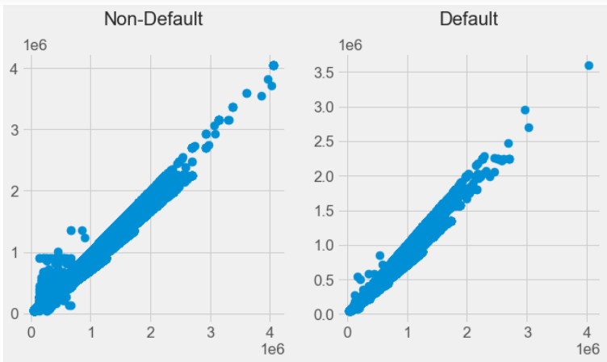
Analysis for Amount Credited VS Price of Goods
Strong correlation between Credit Amount and Price of Goods.
Defaulters are lower where the price of gooos is > 150K

Slide 20
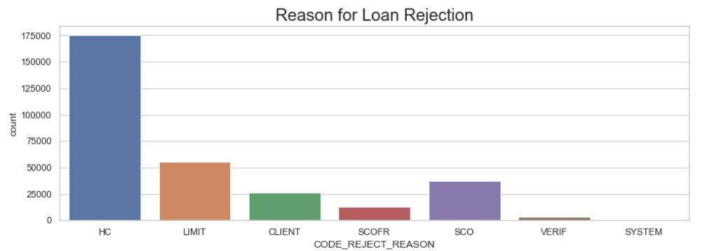
Reason for loan rejection
HC (Historical Cost is the major reason for Loan rejection)

Slide 21
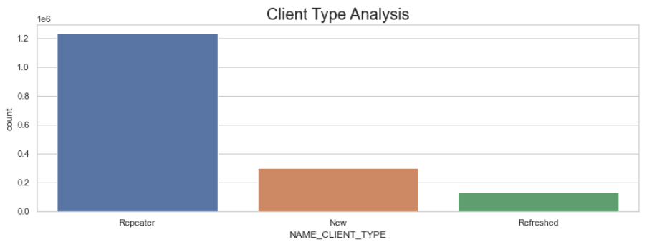
Client type analysis
Majority of clients are repeaters

Slide 22
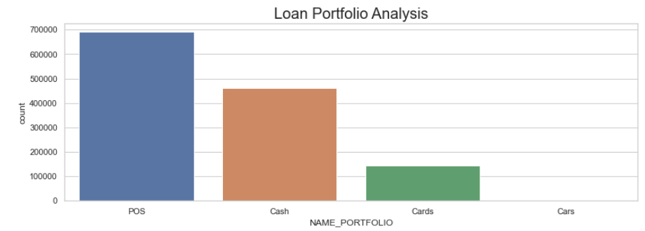
loan portfolio analysis
We observe that majority of previous application is for POS and a good amount of it is for cash.

Slide 23
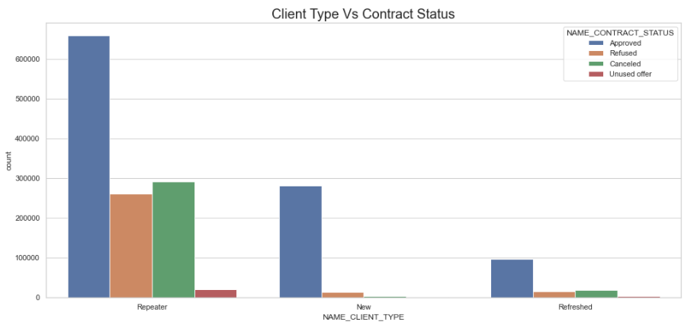
client type vs contract status
Repeat customers are applying for loan again.
Most of the new and Refreshed applications are approved.

Slide 24
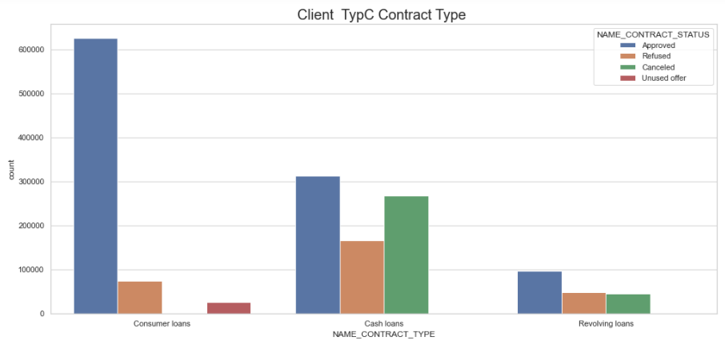
contract type vs contract status
Most of the applications are for Consumer loans, followed by Cash and Revolving loans.
The rejection rate is more for Cash loans.

Slide 25
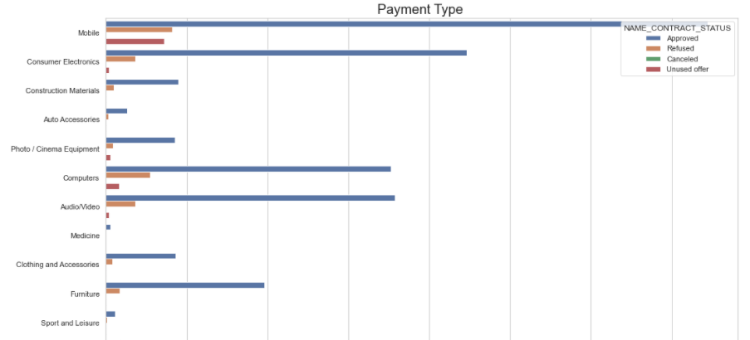
payment type vs good category
Majority of loans are for mobiles, consumer electronics, computers and furniture. We have a considerable rejection rate for this categories as well.

Slide 26
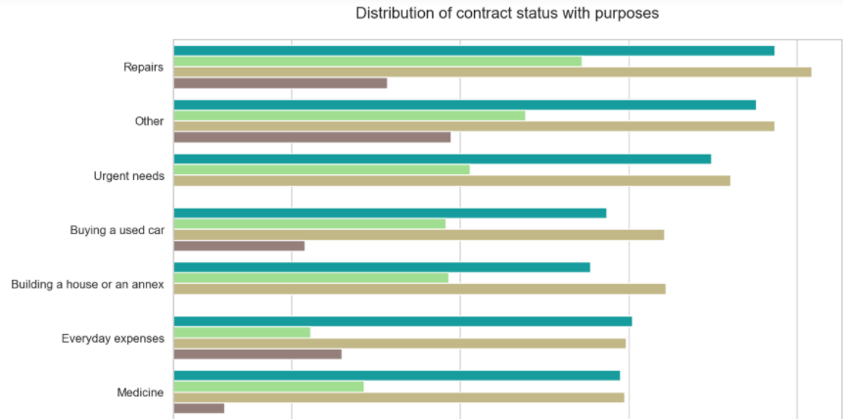
payment type vs goods category
Loans taken for 'repairs' are rejected more often
Education loans are having 50% approvals and 50% rejections
Loans taken for paying existing loans and for buying a new car is having significant higher rejection rate

Slide 27
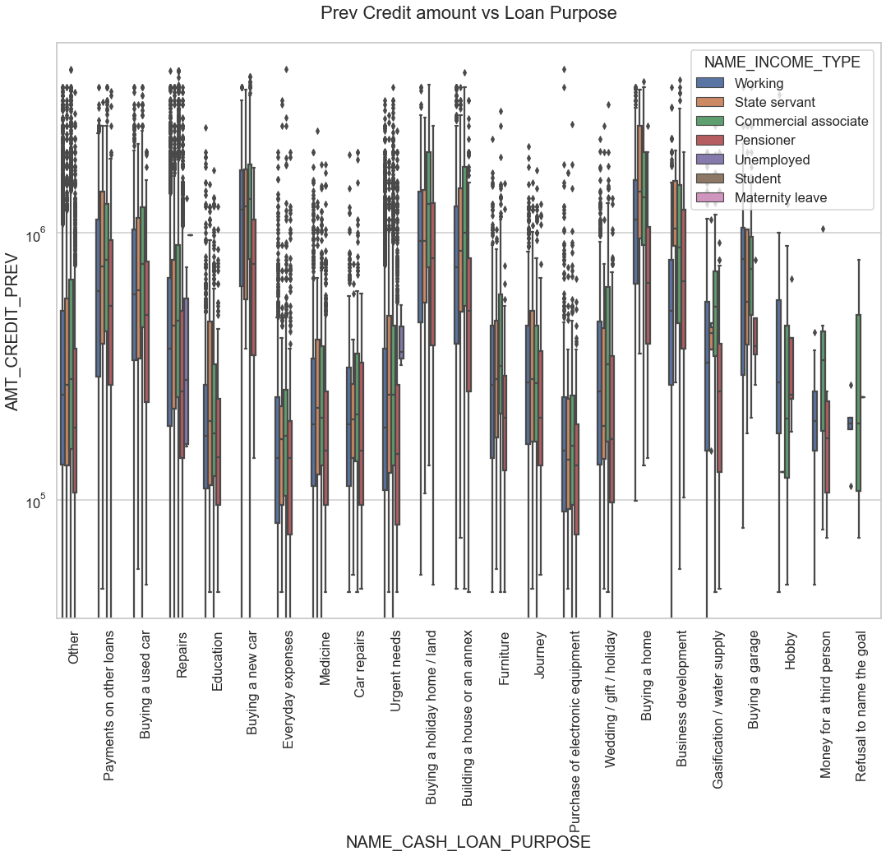

Slide 28
Observations:-
The credit amount is higher for Loan purposes like 'Buying a home’, 'Buying a land’, 'Buying a new car' and’ Building a house'
Government employees having a higher credit compared to other categories
Loan applied for Money for third person or a Hobby is having lesser credits

Slide 29
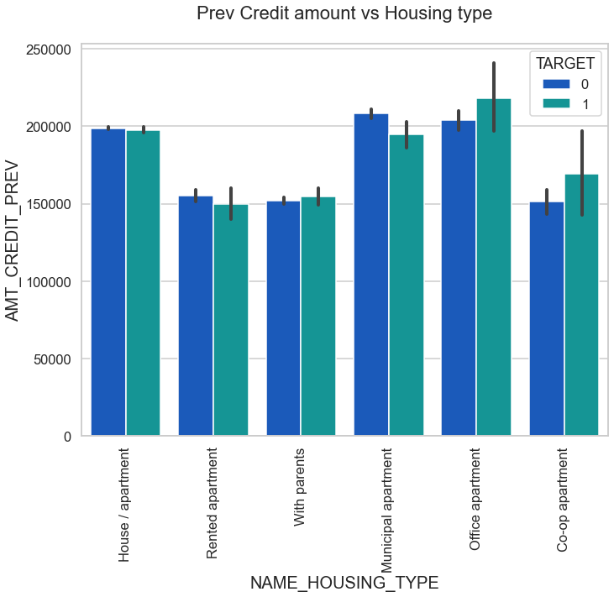
Office apartment is having higher credit for target 0
Co-op apartment is having higher credit of target 1
So, we can infer that bank should avoid giving loans to the housing type of co-op apartment as they are having difficulties in payment

Slide 30
Conclusion:-
The clients with occupation type as ‘Low skilled Laborers’ are the driving factors for Loan Defaulters.
The percentage of non-defaulters are 92% and defaulters are 8%.
Education plays a major role in defaulting the loan: -
Education type ‘Lower Secondary’ – likely to default.
Higher education – less likely to default.
Clients who are not revealing the goal of loan – likely to default.
The bank lends more to female clients as cash loans.
The majority of non-defaulters are clients who are having higher income and having higher loan amount.

Slide 31

Still more analysis can be done…..
“If you torture the data long enough, it will confess.” — Ronald H. Coase

